Slide 1

Models
Persistency of a Drug
Team: Quantic
Members: Ansel Vallejo
Date: November 30th , 2023

Slide 2
Agenda
Business Problem
Logistic Regression
Decision Tree
Random Forest
ROC Curve
Analysis
Conclusion

Slide 3
Business Problem
ABC Pharma Company, in its relentless pursuit of pharmaceutical excellence, grappled with a persistent challenge: understanding the duration of drug persistence aligned with physician prescriptions. To surmount this obstacle, ABC Pharma astutely partnered with Quantic, a trailblazer in streamlining and automating processes. Through the strategic application of data analytics, the pharmaceutical titan aimed to unravel intricate drug persistency patterns, empowering informed decision-making and ushering in a new era of superior patient care. This synergistic collaboration between ABC Pharma and Quantic underscores a steadfast commitment to harnessing the power of data-driven solutions, effectively tackling pivotal industry challenges head-on. The ultimate objective remains crystal clear: to accurately predict patient adherence to physician-prescribed treatments, ensuring uninterrupted medication adherence throughout the course of therapy.

Slide 4
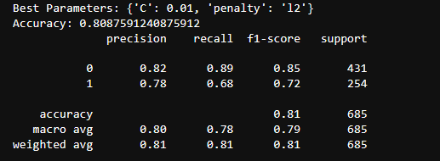
Logistic Regression
The logistic regression model, with regularization parameters set to {'C': 0.01, 'penalty': 'l2'}, achieved an overall accuracy of approximately 80.88% on the test dataset. It demonstrated good precision (82%) and recall (89%) for class 0, indicating accurate predictions for the majority class. For class 1, precision was 78%, and recall was 68%, suggesting a somewhat balanced performance in identifying instances of the minority class.

Slide 5
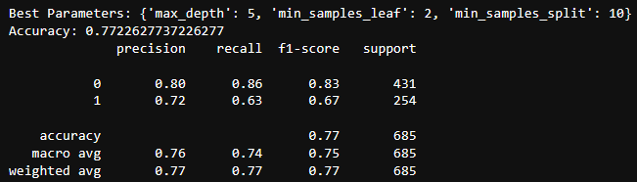
Decision Tree
The decision tree model, optimized with {'max_depth': 5, 'min_samples_leaf': 2, 'min_samples_split': 10}, yielded an accuracy of 77.23% on the test dataset. It exhibited commendable precision (80%) and recall (86%) for class 0, signifying accurate predictions for the majority class. However, for class 1, precision was 72%, and recall was 63%, suggesting a somewhat imbalanced performance in identifying instances of the minority class.

Slide 6
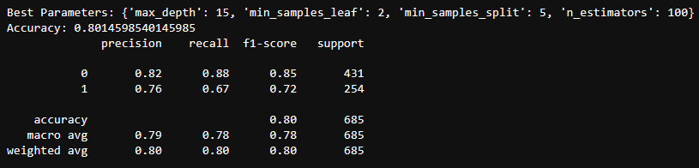
Random Forest
The random forest model, tuned with {'max_depth': 15, 'min_samples_leaf': 2, 'min_samples_split': 5, 'n_estimators': 100}, achieved an accuracy of 80.15% on the test dataset. It demonstrated solid precision (82%) and recall (88%) for class 0, indicating accurate predictions for the majority class. For class 1, precision was 76%, and recall was 67%, reflecting a balanced performance in identifying instances of the minority class. Overall, the random forest model showed favorable results with a macro-average F1-score of 78%.

Slide 7
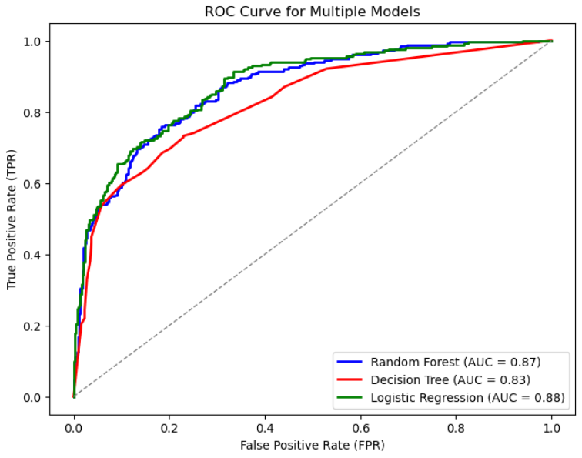
ROC Curve

Slide 8
ROC Curve
Logistic Regression (AUC = 0.88):
The logistic regression model demonstrates a strong ability to discriminate between the positive and negative classes. An AUC of 0.88 suggests that the model's true positive rate is high while keeping the false positive rate relatively low across different probability thresholds.
Decision Tree (AUC = 0.83):
The decision tree model, with an AUC of 0.83, also indicates a good discriminatory power. Although slightly lower than logistic regression, an AUC of 0.83 still suggests effective separation between the classes at different decision thresholds.
Random Forest (AUC = 0.87):
The random forest model performs well with an AUC of 0.87. This indicates that the ensemble of decision trees in the random forest collectively provides a strong ability to discriminate between the positive and negative classes.

Slide 9
Analysis
Logistic Regression: This model shows the highest overall accuracy and a good balance between precision and recall for both classes. It performs well on the majority class (Class 0) and reasonably well on the minority class (Class 1).
Decision Tree: While achieving a slightly lower accuracy compared to logistic regression, the decision tree model has solid precision and recall for the majority class. However, it shows a lower recall for the minority class, indicating a potential challenge in identifying instances of Class 1.
Random Forest: The random forest model provides competitive accuracy and performs well in terms of precision and recall for both classes. It offers a balanced trade-off between the two classes, with a notable performance on the majority class.

Slide 10
Conclusion
Overall Consideration:
Based on a comprehensive evaluation of accuracy, AUC, precision, recall, and F1-score, the Logistic Regression model appears to be a strong performer, showing a good balance across multiple metrics.

Slide 11
Thanks! ☺

